Slide 1
Sleep tracking app for better night rest
Team Members:
C.Indhupriya
T. Dhivya
A.Mina Fathima
P. Shalini

Slide 2
Objective of the project
Promote Healthy Lifestyle Habits: Encourage users to adopt better sleep routines and healthier diets by offering personalized tips and motivational content based on their sleep patterns.
To develop a comprehensive Sleep Tracker App using Kotlin and Firebase that not only monitors sleep patterns but also provides personalized diet suggestions, morning motivational content, and bedtime stories to enhance users' sleep quality and overall well-being.

Slide 3
System requirements for the project
Software: Android Studio, Kotlin, Firebase Console
Hardware: Android device or emulator (Android 7.0 or higher)
Libraries/Dependencies:Firebase Firestore, Authentication, and Realtime Database
Android Jetpack (Lifecycle, LiveData, ViewModel)
Internet access for Firebase services

Slide 4
SOURCE CODE:
MAIN.APP.XML
<?xml version="1.0" encoding="UTF-8"?> <project version="4"> <component name="AutoImportSettings"> <option name="autoReloadType" value="NONE" /> </component> <component name="ChangeListManager"> <list default="true" id="dae158cb-e917-4fed-ab27-039a978af4f8" name="Changes" comment="" /> <option name="SHOW_DIALOG" value="false" /> <option name="HIGHLIGHT_CONFLICTS" value="true" /> <option name="HIGHLIGHT_NON_ACTIVE_CHANGELIST" value="false" /> <option name="LAST_RESOLUTION" value="IGNORE" /> </component> <component name="ClangdSettings"> <option name="formatViaClangd" value="false" /> </component> <component name="CoverageOptionsProvider"> <option name="myAddOrReplace" value="0" /> </component> <component name="ProjectColorInfo">{ &quot;associatedIndex&quot;: 3 }</component> <component name="ProjectId" id="2oqHzIlC0LtCUNyVzuaSUhsf2B3" />

Slide 5
</component> <component name="PropertiesComponent"><![CDATA[{ "keyToString": { "Gradle.sleep tracking application.executor": "Run", "RunOnceActivity.ShowReadmeOnStart": "true", "RunOnceActivity.cidr.known.project.marker": "true", "RunOnceActivity.readMode.enableVisualFormatting": "true", "cf.first.check.clang-format": "false", "cidr.known.project.marker": "true", "com.google.services.firebase.aqiPopupShown": "true", "deletionFromPopupRequiresConfirmation": "false", "last_opened_file_path": "C:/Users/lenovo/Downloads/andfun-kotlin-sleep-tracker-master-20241114T131903Z-001", "settings.editor.selected.configurable": "editor.preferences.tabs" } }]]></component> <component name="RunManager"> <configuration name="sleep tracking application" type="GradleRunConfiguration" factoryName="Gradle" activateToolWindowBeforeRun="false"> <ExternalSystemSettings> <option name="executionName" /> <option name="externalProjectPath" value="$PROJECT_DIR$/andfun-kotlin-sleep-tracker-master/gradle" /> <option name="externalSystemIdString" value="GRADLE" /> <option name="scriptParameters" value="-D" /> <option name="taskDescriptions"> <list />

Slide 6
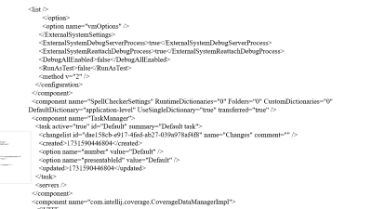
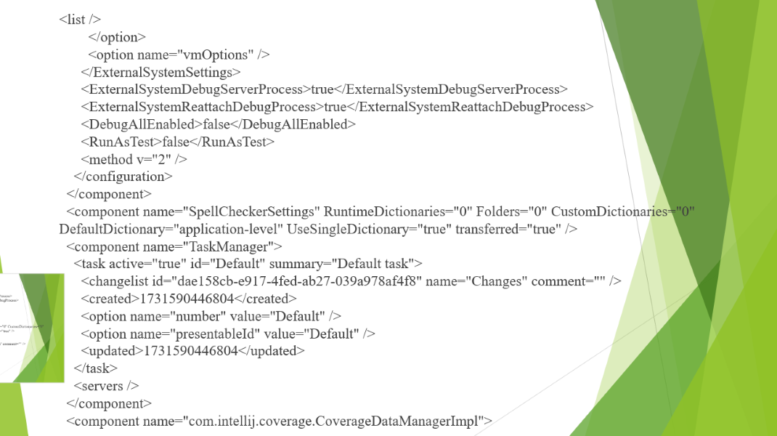
<list /> </option> <option name="vmOptions" /> </ExternalSystemSettings> <ExternalSystemDebugServerProcess>true</ExternalSystemDebugServerProcess> <ExternalSystemReattachDebugProcess>true</ExternalSystemReattachDebugProcess> <DebugAllEnabled>false</DebugAllEnabled> <RunAsTest>false</RunAsTest> <method v="2" /> </configuration> </component> <component name="SpellCheckerSettings" RuntimeDictionaries="0" Folders="0" CustomDictionaries="0" DefaultDictionary="application-level" UseSingleDictionary="true" transferred="true" /> <component name="TaskManager"> <task active="true" id="Default" summary="Default task"> <changelist id="dae158cb-e917-4fed-ab27-039a978af4f8" name="Changes" comment="" /> <created>1731590446804</created> <option name="number" value="Default" /> <option name="presentableId" value="Default" /> <updated>1731590446804</updated> </task> <servers /> </component> <component name="com.intellij.coverage.CoverageDataManagerImpl">

Slide 7
<SUITE FILE_PATH="coverage/andfun_kotlin_sleep_tracker_master_20241114T131903Z_001$sleep_tracking_application.ic" NAME="sleep tracking application Coverage Results" MODIFIED="1731592710136" SOURCE_PROVIDER="com.intellij.coverage.DefaultCoverageFileProvider" RUNNER="idea" COVERAGE_BY_TEST_ENABLED="false" COVERAGE_TRACING_ENABLED="true" /> </component> </project>
Modules.xml
<?xml version="1.0" encoding="UTF-8"?> <project version="4"> <component name="Project Module Manager"> <modules> <module file url="file://$PROJECT_DIR$/.idea/andfun-kotlin-sleep-tracker-master-20241114T131903Z-001.iml" file path="$PROJECT_DIR$/.idea/andfun-kotlin-sleep-tracker-master-20241114T131903Z-001.iml" /> </modules> </component> </project>
MISC.xml
<?xml version="1.0" encoding="UTF-8"?> <project version="4"> <component name="ProjectModuleManager"> <modules> <module fileurl="file://$PROJECT_DIR$/.idea/andfun-kotlin-sleep-tracker-master-20241114T131903Z-001.iml" filepath="$PROJECT_DIR$/.idea/andfun-kotlin-sleep-tracker-master-20241114T131903Z-001.iml" /> </modules> </component> </project>

Slide 8
App insightsSettings.xml
<?xml version="1.0" encoding="UTF-8"?>
<project version="4">
<component name="AppInsightsSettings">
<option name="selectedTabId" value="Android Vitals" />
</component>
</project>
And fun-Kotlin-sleep tracker.xml
<?xml version="1.0" encoding="UTF-8"?>
<module type="JAVA_MODULE" version="4">
<component name="NewModuleRootManager" inherit-compiler-output="true">
<exclude-output />
<content url="file://$MODULE_DIR$" />
<orderEntry type="inheritedJdk" />
<orderEntry type="sourceFolder" forTests="false" />
</component>
</module>

Slide 9
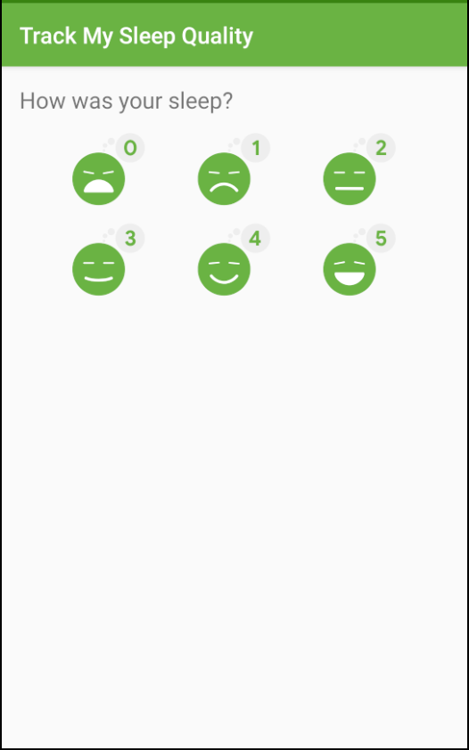
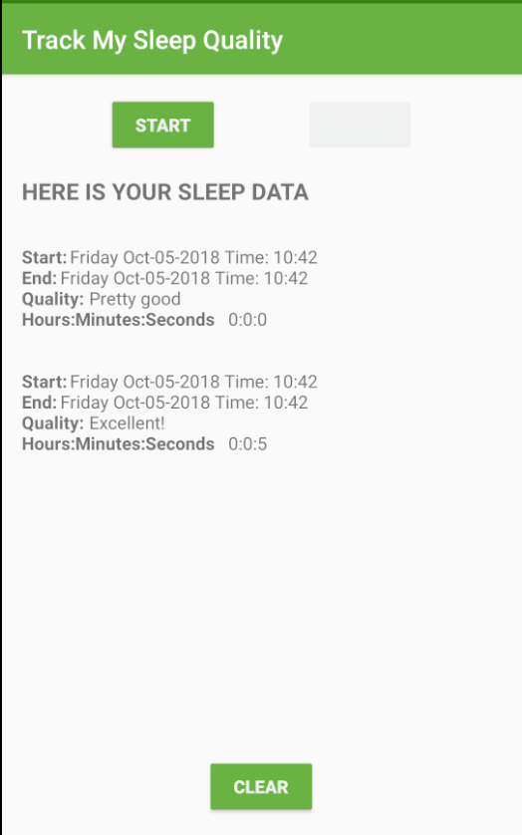
Gitignore:
# Default ignored files
/shelf/
/workspace.xml
Output:

Slide 10
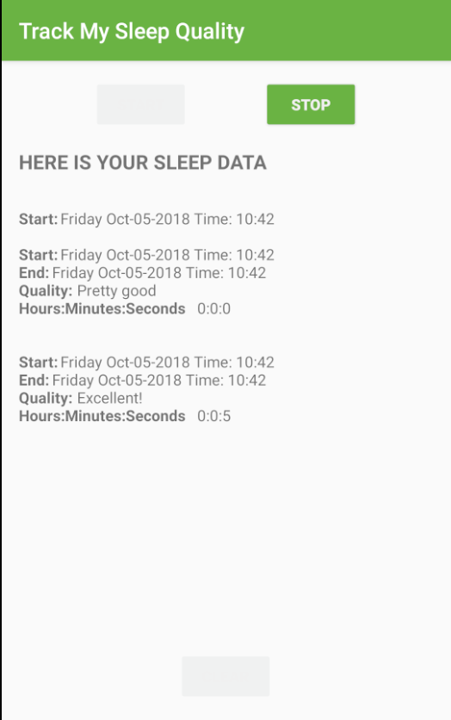

Slide 11
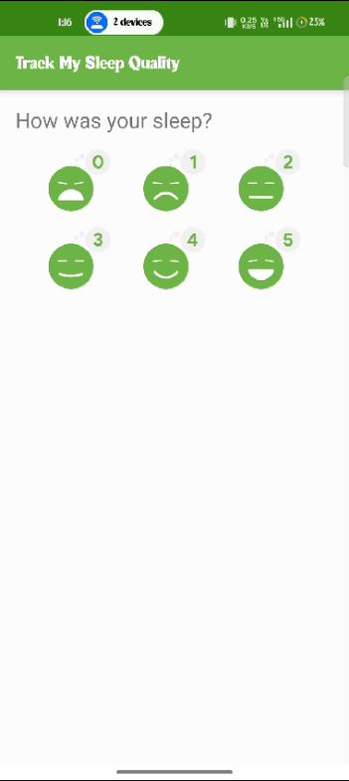
Demo video

